Slide 1
Notes:
Welcome to this video series on tensors… where I explain what tensors are and why you should care…
-Going to try and do this with as few pre-requisites as possible
-lin alg, matrix multiplication, linear combinations, and determinants
- avoid calculus
So what is a tensor?

Slide 2
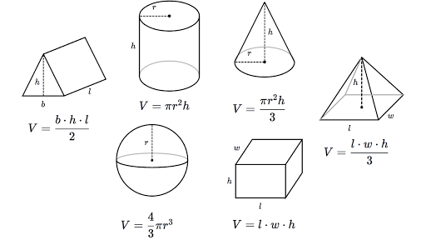
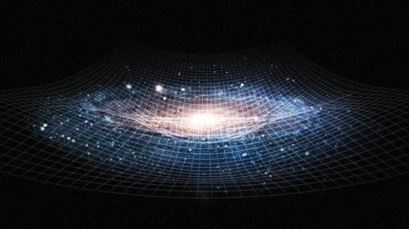
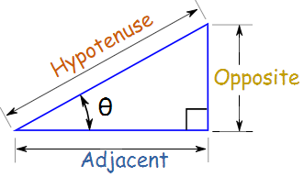
Tensors = Geometry
Notes:
Now I’m not talking about geometry you learned in elemetry school, I mean non-obvious geometry If we understand tensors, we can understand complicated geometric ideas.

Slide 3
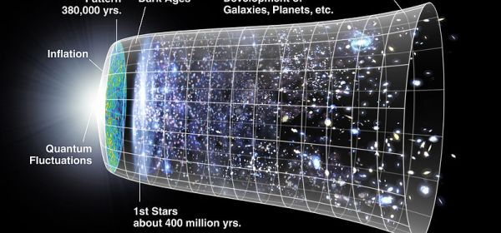
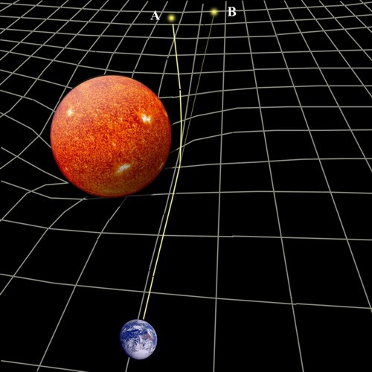
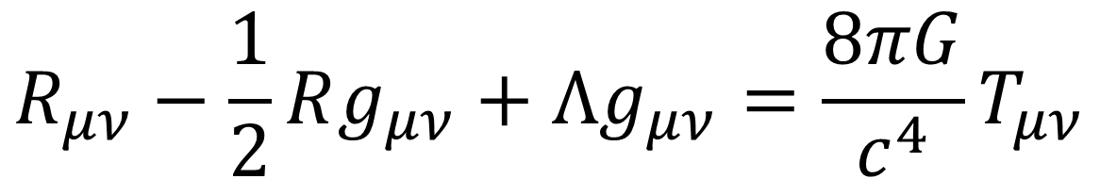
General Relativity
Universe is expanding
Space-time is curved
$$R_{μν}−\frac{1}{2}Rg_{μν}+Λg_{μν}=\frac{8πG}{c^{4}}T_{μν}$$
Notes:
If you’re read or watched some popular science articles or videos, you’ve probably heard about how spacetimes is curved. Another thing… universe is expanding? What do either of these things even mean? In order to understand these ideas mathematically, not just intuitively, we need tensors. Gonna throw up an equation…. Einstein’s field equations… this tells us how spacetime is curve and why the universe is expanding It uses tensors. These are all 4x4 rank 2 tensors. Matrices. The most important on is this term here… the metric tensor. It tells us how to measure distances in weird geometries.
I’m going to talk about the metric tensor in video 7 or 8. I’m not going to say you’ll understand relativity, but you’ll understand what the metric tensor does and the first steps to how it might be used in relatvitity.

Slide 4
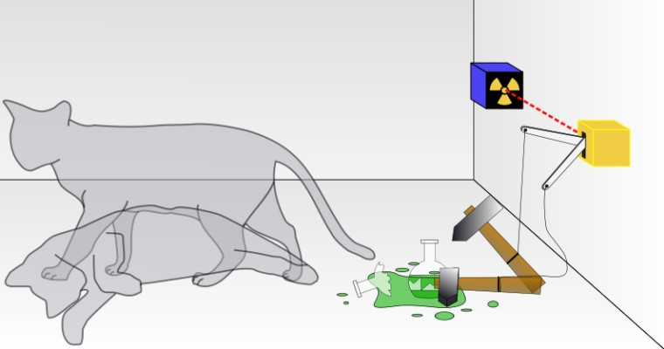
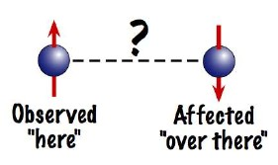
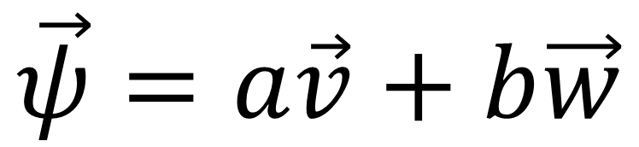
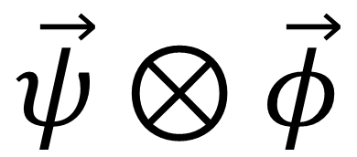
Quantum Mechanics + Quantum Computing
Quantum Superposition
Quantum Entanglement
$$\vec{ψ}=a\vec{v}+b\vec{w}$$
$$\vec{ψ}⊗\vec{φ}$$
Notes:
Another example… Quantum computing is a an active
If you’ve read or watched popular science articles or videos you’ve probably heard about “quantum superposition”, and how quantum systems can be in two states at once… Quantum entanglement where particles, even on 100s of kilometers away, can influence each other because they are entangled.
What does this even mean? Superposition… is just linear combinations
Entanglement, is really just combining geometric spaces using the tensors product, I’ll be talking about the tensor product in videos 9-10.

Slide 5
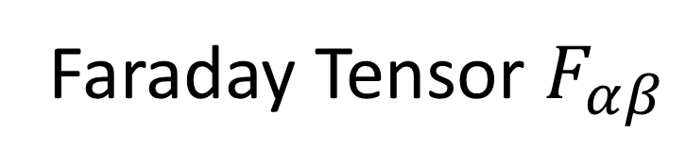
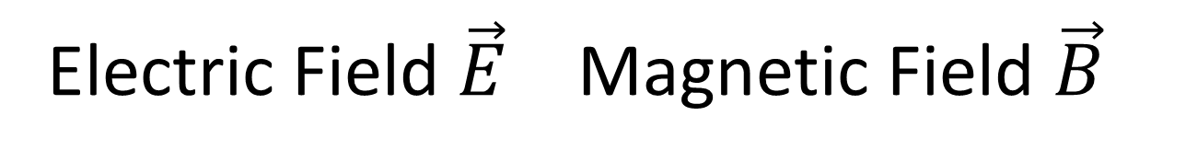
Electricity + Magnetism
Electric Field $\vec{E}$ Magnetic Field $\vec{B}$
Faraday Tensor $F_{αβ}$
Notes:
LAst example, not going to go into too much detail..

Slide 6
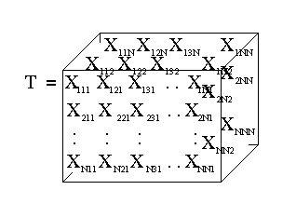
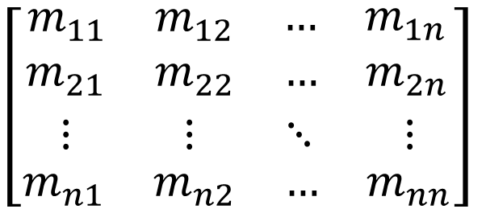
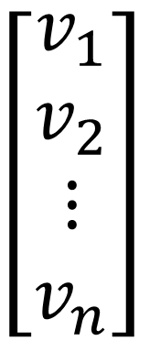

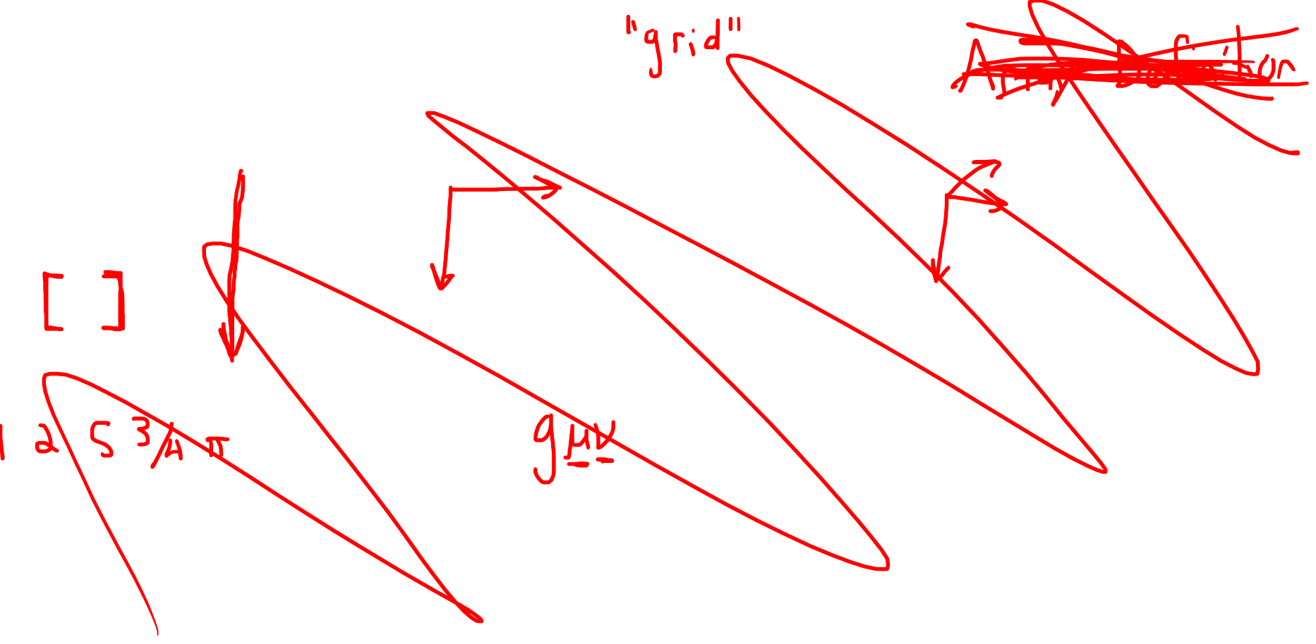
1. Tensor = multi-dimensional array of numbers
$$\left[\begin{aligned}v_{1} \\ v_{2} \\ ⋮ \\ v_{n}\end{aligned}\right]$$
$$\left[\begin{aligned}\begin{matrix}\begin{matrix}m_{11} & m_{12}\end{matrix} & \begin{matrix}… & m_{1n}\end{matrix}\end{matrix} \\ \begin{matrix}\begin{matrix}m_{21} & m_{22}\end{matrix} & \begin{matrix}… & m_{2n}\end{matrix}\end{matrix} \\ \begin{matrix}\begin{matrix}⋮ & ⋮\end{matrix} & \begin{matrix}⋱ & ⋮\end{matrix}\end{matrix} \\ \begin{matrix}\begin{matrix}m_{n1} & m_{n2}\end{matrix} & \begin{matrix}… & m_{nn}\end{matrix}\end{matrix}\end{aligned}\right]$$
$$s$$
Scalar
(rank 0)
Vector
(rank 1)
Matrix
(rank 2)
Rank-3 Tensor
(rank 3)
Notes:
First definition of a tensor… (read) Now this definition, it’s not quite right, but it’s a good starting point. So let’s see some examples (basically a number, list of numbers, box of numbers…) Why care about tensors? What are these arrays of numbers good for?

Slide 7
2. Tensor = an object that is invariant under a change of coordinates, and…

Slide 8


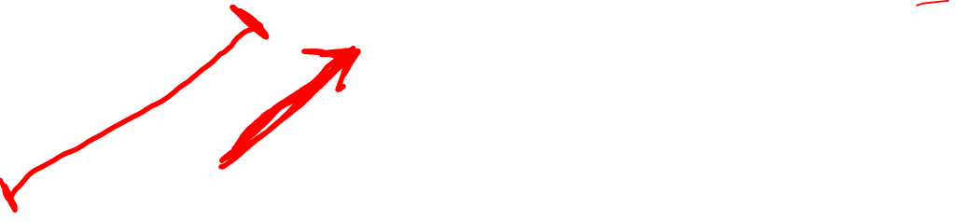
2. Tensor = an object that is invariant under a change of coordinates, and…
has components that change in a special, predictable way under a change of coordinates

Slide 9
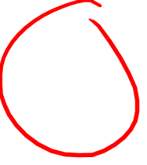
2. Tensor = an object that is invariant under a change of coordinates, and…
has components that change in a special, predictable way under a change of coordinates

Slide 10
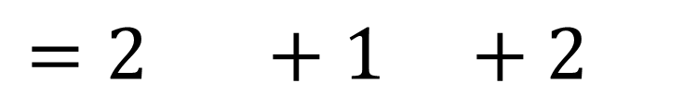
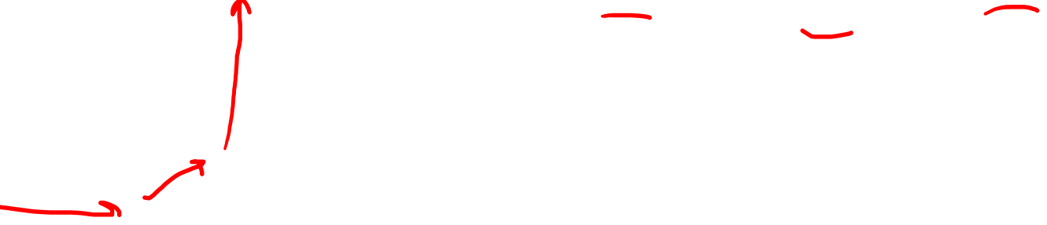
2. Tensor = an object that is invariant under a change of coordinates, and…
has components that change in a special, predictable way under a change of coordinates
$$=2 +1 +2$$

Slide 11
2. Tensor = an object that is invariant under a change of coordinates, and…
has components that change in a special, predictable way under a change of coordinates
$$=2 +1 +2$$

Slide 12
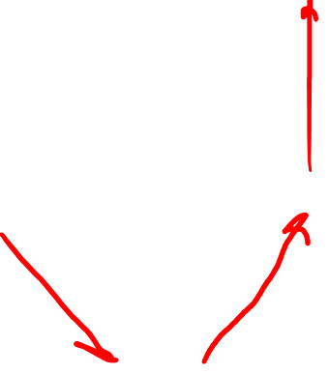
2. Tensor = an object that is invariant under a change of coordinates, and…
has components that change in a special, predictable way under a change of coordinates
$$=2 +1 +2$$

Slide 13
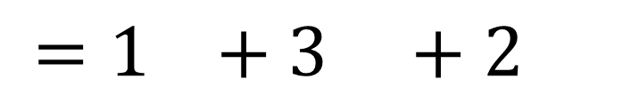
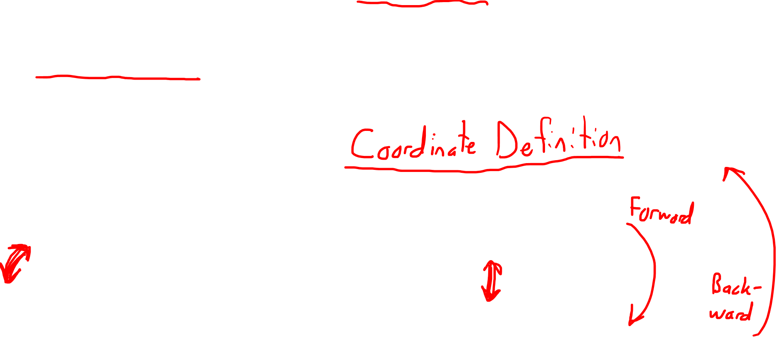
2. Tensor = an object that is invariant under a change of coordinates, and…
has components that change in a special, predictable way under a change of coordinates
$$=2 +1 +2$$
$$=1 +3 +2$$
Notes:
Forward and backward transformations Coordinate definition…

Slide 14
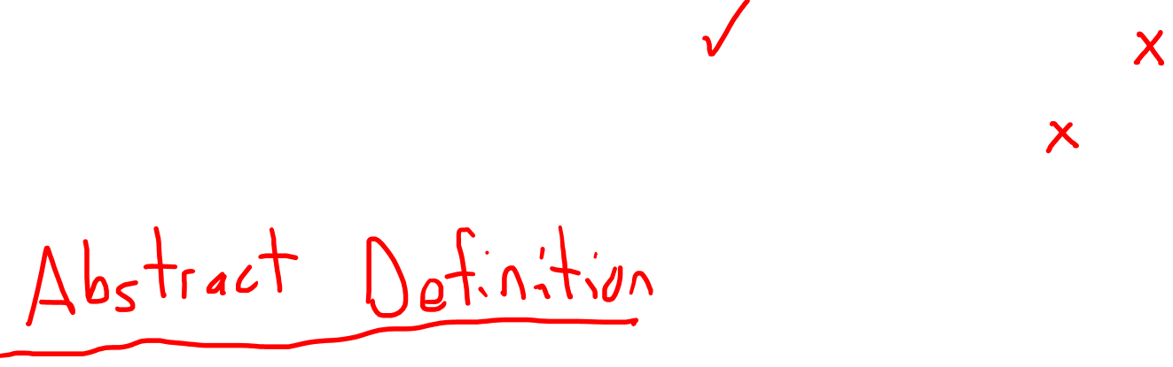
3. Tensor = a collection of vectors and covectors combined together using the tensor product
Notes:
More advanced… You’ve possibly never heard of a covector. Possibly never heard of the tensor product before. But this definition is really nice because we only really need to understand 3 things. We know almost all the basics

Slide 15
Extra: Tensors as partial derivatives and gradients that transform with the Jacobian Matrix
Notes:
For people with some calculus background… I’m gonna talk about

Slide 16
Enjoy!

